Slide 1
Micro-op Cache Presentation
Hawk Wang & Junshi Wang
2020.2.20

Slide 2
Catalog
Trace Cache
Micro-op Cache
HW status
What we do

Slide 3

Trace Cache – Background #1
Core producer/consumer model
IPC = Core instruction bandwidth = min(Front IPC, Back IPC)
Good design: balance front_{ipc} and back_{ipc}
Back_{ipc} : resource-centric(register file, execution unit, ROB/LSQ size)
trend: enlarge resource, gain high performance
front_{ipc} :compatible Back IPC, low latency, high bandwidth

Slide 4
Trace Cache – Background #2
Front_{ipc} factors:
Well studied, influence on latency, indirect on throughput
Instruction cache hit ratio
Branch prediction accuracy
Not studied yet, trace cache focus
Branch throughput: predict more branch(basic block) per cycle, currently only 1 basic block
Non-contiguous instruction alignment: due to taken branch, program flow not same as contiguous layout in instruction cache
Fetch unit latency: when fetch restarts(branch miss resolve), waste cycles that useful instructions to backend

Slide 5
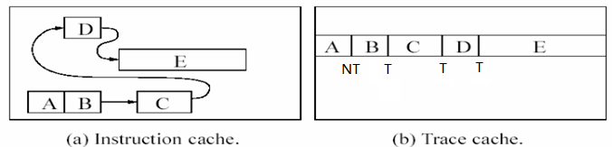
Trace Cache - motivation
Conventional Instruction Cache
Predict only 1 basic block per cycle
Fetch maximum 1 basic block’s instructions limited on fetch boundary
according to [1], average basic block’s instruction number is 4-5 for integer benchmark ( SPEC92 & Instruction Benchmark Suite(IBS) ), float benchmark longer
Trace Cache
A novel cache structure store dynamic program flow --- trace
Trace means multiple “contiguous“ basic blocks. “contiguous” not means contiguous in memory layout, but contiguous on program flow

Slide 6
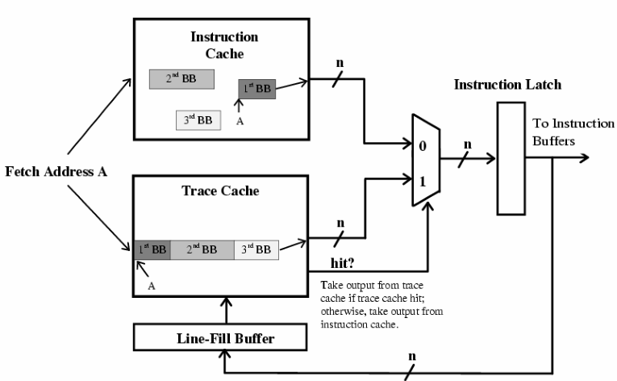
Trace Cache – Initial Architecture #1
Store instruction not micro operation
Not in the critical path – not contribute to pipeline latency
Mainly on conditional branch, not for indirect branch, unconditional branch treated as specific condition branch (no predict result compare)
Big changes in conventional frontend architecture ← IMPORTANT !!!

Slide 7
Trace Cache – Initial Architecture #2
Big changes in conventional frontend architecture ← IMPORTANT !!!
conventional architecture provide same fetch IPC as Trace cache
Multiple branch predictor
Direction predict Predict more condition direction per cycle, reduce accuracy
BTB Provide more branch target address per cycle
Interleave instruction cache organization provides parallel accesses on more instruction address

Slide 8
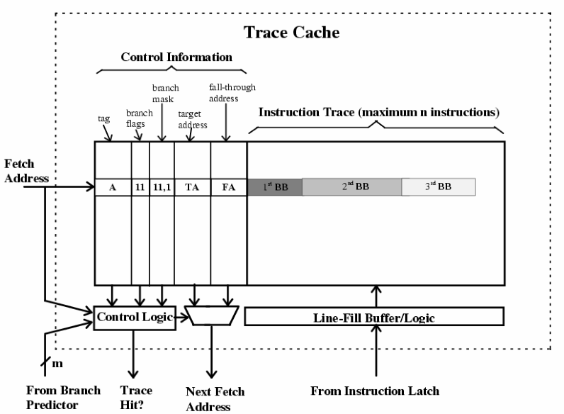
Trace Cache – Initial Architecture #3
Trace Cache line structure
line store max(n insts, m branches)
“Hit” means tag + bp_result match
“branch flags” store trace bpu history result
“branch mask” Number of branches in trace
Last bit indicate trace whether end with branch

Slide 9
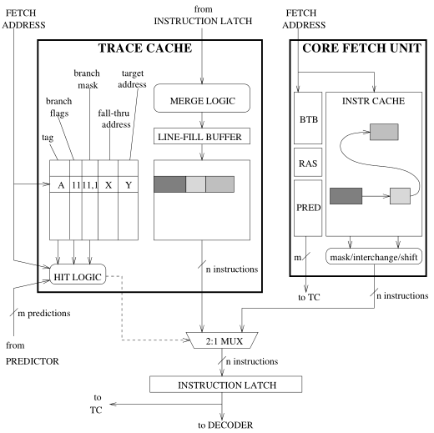
Trace Cache – Initial Architecture #4
Micro-architecture

Slide 10
Trace Cache – Design Issues #1
Trace Cache is HW cache component, many design issues related to cache issues
Cache related issues
Size / Associativity Large is good, but more cost
Indexing function Simple method only use fetch address; Path associativity: index = {fetch addr, predict result} or F(fetch addr, predict result). Ex, “ABC” and “ABD” will locate in different entry
Fill mechanism Whether support outstanding misses. Simple method miss after miss will stall previous miss done Fill trace in speculative path or commit path
Partial matches Hit partial predict result, whether provide trace prefix; more line bits, need store intermediate branch & fall-through target
Replacement policy Good replacement will improve hit ratio, but from disclosed papers not focus on this issue

Slide 11
Trace Cache – Design Issues #2
Trace specific issues
Trace selection
Trace structure instruct number and branch number, which hit will terminate current trace
Trace end ret / indirect branch / exception will end current trace
Structure improve trace cache hit rate
Special structure store recent traces, exceed threshold update to trace cache
Victim cache store useful but replacement traces

Slide 12
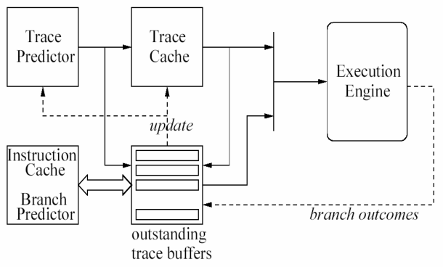
Trace Cache – Aggressive architecture #1
Initial architecture work on instruction level, involve:
Multiple branch predictor low accuracy than conventional branch predictor
Refine branch predictor on trace level, frontend work on trace-centric

Slide 13
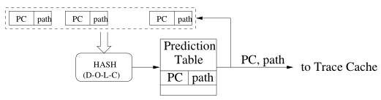
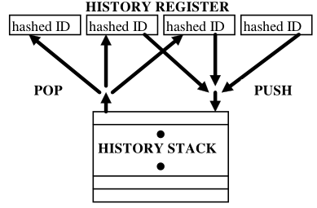
Trace Cache – Aggressive architecture #2
Trace identity
Instead of fetch address
trace identify = {fetch addr, branch outcome}
Trace predictor
Return-History-Stack, correlated global predictor
criteria
Trace Cache
Index by trace identity, with folding
Trace buffers
Treat as line fill buffer
Conventional instruction cache
simple BPU(local branch)
More on correlated global predictor
Each entry = { trace identity, saturate counter}
only counter == 0, will update entry
hit counter + 1; miss counter - 2

Slide 14
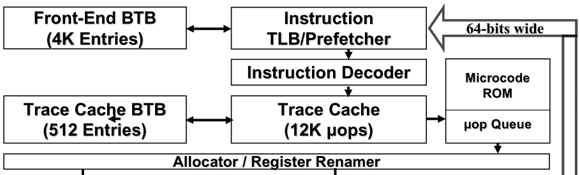
Trace Cache – real implement #1
Trace Cache involve in P4(NetBurst) microarchitecture [3][4]
Support for “SMC” issue, technology referred by micro-op cache
Replace L1 instruction cache totally, decode & fetch logic locate in L2 Cache
Store micro operations, not x86 instruction
VIVT(virtual index / virtual tag), need flush when task switch, no use “trace identity” technology
Provide Trace predictor (small) & conventional predictor (large)

Slide 15
Trace Cache – real implement #2
Trace Cache involve in P4(NetBurst) microarchitecture [3][4]
Trace built in Trace cache with link-list by line data
LA: only trace head has, used for tag a trace
Next way / Prev way: indicate next link node position
set (next (X+1)%S; prev X-1)%S )
UIP/UIP_VALID: trigger MSROM address
NLIP: next trace address

Slide 16
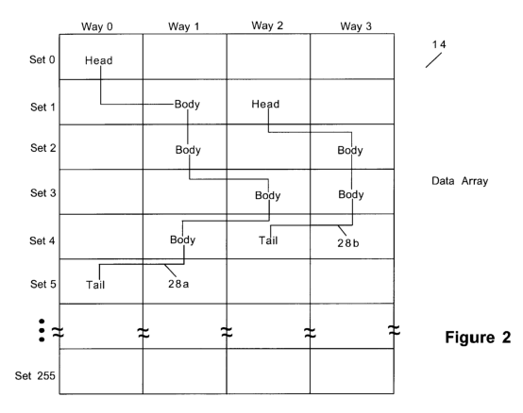
Trace Cache – real implement #3
Trace Cache involve in P4(NetBurst) microarchitecture [3][4]
Line data termination condition
Complex x86 instruction, trigger MSROM
Line maximum contain up to 2 branch micro-op
Can’t fit one x86 instruction
Trace termination condition
Encounter indirect jmp, call, return
Branch mis-prediction, exception / interrupt
Exceed a trace capacity, maximum 64 sets

Slide 17
Trace Cache – real implement #1
Performance: 12K micro-ops trace cache similar hit rate to 8KB to 16KB instruction cache
Pitfalls
Low decode bandwidth, decode work on 64bit data, 1 x86 per cycle
Trace cache has redundant trace pieces due to only trace head has location address
More conflict on trace entries, especially for some trace will be broken by some body overwritten by another trace. Trace Cache used a replacement not same as conventional “LRU”

Slide 18
Trace Cache – real implement #2
Intel some gens Core based on P4 [5]
 | Pentium 4 Northwood, SP Prestonia, DP Gallatin, MP | Pentium 5 Prescott, SP Nocona, DP | Pentium 6 “Yamhill”, SP Jayhawk, DP Potomac, MP
Trace Cache | 12k uOPs/ 80KB 256 sets / 8 ways 6 uOPs per trace-line 53bit per uOP | 16k uOPs / 128KB 512 sets / 8 ways 4 uOPs per trace-line 64bit per uOP | 16k uOPs / 128KB 512 sets / 8 ways 4 uOPs per trace-line 64bit per uOP
Trace Cache bandwidth | 3 uOPS / cycle | 4 uOPS / cycle | 4 uOPS / cycle
Trace Cache BP | 512 entires | 1024 entries | 1024 entries

Slide 19
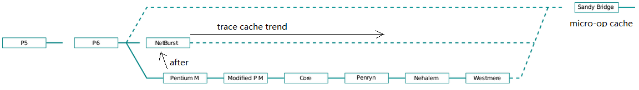
Micro-op Cache #1
Conclusion: Trace cache is replaced by micro-operation cache
Review trace cache design decision:
Low decoder bandwidth, only decode 1 x86 / cycle, if trace miss, build latency high
Inefficient storage usage, due to trace storage mechanism, many entries conflict, reduce trace hit ratio
Small dedicated Trace predictor, maybe not very accuracy implement (not many disclosed document on this)
Trace assumption, long trace assumption, but maybe in real application, long trace not always persistence
Need a large state-machine sync trace cache stream / build mode, waste power

Slide 20
Micro-op Cache #2
Micro-op Cache is implement improvement of Trace cache on x86 Core
How micro-op Cache improvement
Reserved conventional frontend, micro-op Cache just a bypass path
No trace predictor
Trace assumption, trace only contain 1 basic block
Result:
micro-op cache 1.5K uOPs similar hit ratio to 6KB instruction cache, while 12K uOPs trace cache similar hit ratio to 8KB-16KB instruction cache, improve storage efficiency about 4X or more. Intel claim micro-op cache hit ratio ~80%

Slide 21
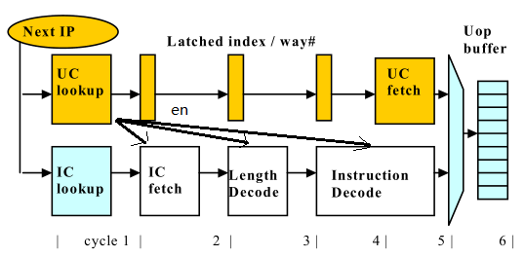
Micro-op Cache – Architecture [6] #1
As L0i cache, inclusion with L1i cache (“coherency”)
No big change in frontend design, just add bypass path
Power/clock-gating legacy decode path when micro-op cache hit consecutively
UC cache is serialization cache, reducing power

Slide 22
Micro-op Cache – Architecture [6] #2
UC cache is serialization cache, reducing power
Work on “basic block”, not trace
Predetermined instruction length (counted as line number, ex, 3 in Intel patent)
Conditional / unconditional branch, call, return
Complex instruction trigger MSROM
Exception / interrupt
Next IP calculated by conventional BPU
Support SMC, same mechanism as Trace cache

Slide 23
Micro-op Cache – Design Issues
Size / associativity
Fill Mechanism
Speculative vs. commit fill
Outstanding fill buffer
Replacement policy
Trace selection & organization
Trace line structure

Slide 24
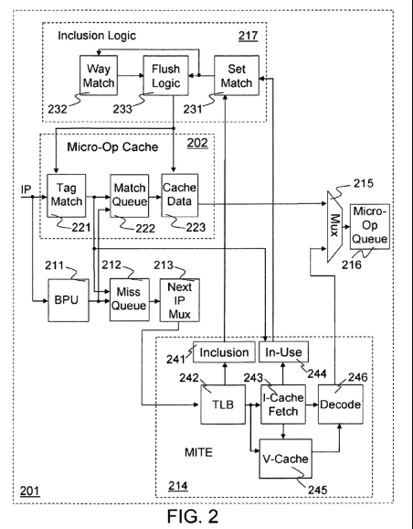
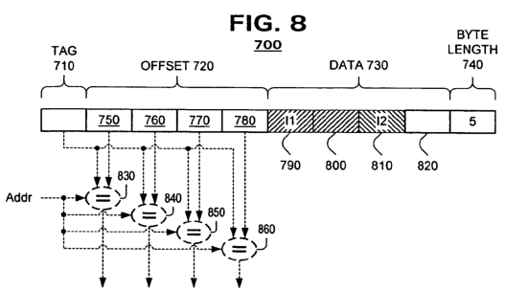
Micro-op Cache – real implementation #1
Introduced in Sandy-bridge microarchitecture [7][8]
Notes:
Compare Trace Cache:
1 Improvement storage efficiency, how: line structure, simple assumption(on basic block, not trace)
2. Simple implementation, no trace predictor
3. Involve power-gating to reduce power due to bypass path

Slide 25
Micro-op Cache – real implementation #2
Special features
L1i evict, then micro-op cache related entries flushed
Work on 32B instruction window, if partial match in 32B window, go to legacy decode path
New line condition
X86 not fit in one line capacity
Branch misprediction, restart instruction fetch
Block end indication condition
Replacement: standard LRU policy
Fill mechanism: outstanding, speculative
VIVT, Line structure, store offset, support hit in “middle” of way
Notes:
Compare Trace Cache:
1 Improvement storage efficiency, how: line structure, simple assumption(on basic block, not trace)
2. Simple implementation, no trace predictor
3. Involve power-gating to reduce power due to bypass path

Slide 26
Micro-op Cache – real implementation #3
Intel microarchitecture configuration
 | Sandybridge | Haswell | Skylake | Sunnycove
Micro-op cache | 1536 uOPs 8 ways, 32 sets 6 uOP per line Statically divide thread Inclusive with L1i $ 32B window | Same left | Same left Inclusive with L1i $ 64B window | 2304 uOPs 8ways, 48 sets 6 uOP per line Statically divide thread Inclusive with L1i $ 64B window
Micro-op cache bandwidth | 4 uOP per cycle | Same left | Same left | 5 uOP per cycle

Slide 27
Micro-op Cache – Conclude #1
Micro-op cache is implementation optimization on Trace cache
Many implementation issues need consideration
SMC support (communication on iTLB & iCache), how to flush obsolete micro-ops [described in USA patent], belong to functionality, not performance
Which power-gating policy used
L1i $ lookup never power-gate, no penalty on frontend switch
As current Intel does, incur 1-2T penalty
Sync between MITE & Micro-op Cache (Intel current use a side-band synchronize signal along pipeline)
Fill buffer design

Slide 28
Micro-op Cache – Conclude #2
Micro-op cache is implementation optimization on Trace cache
Issues related to architecture (we can touch?)
Size / associativity
Trace selection vs. Instruction window
Line structure
Micro-op data array throughput design (how many r/w per cycle)

Slide 29
HW status
Heard from HW guys discuss, not very sure
Already explore size / associativity
Already study line structure (how many uOPs stored), how about meta-info?
Trace selection issue?
More design specific issues should not start
How to explore
Dump uOP sequences from RTL simulation environment, then use trace model to simulate

Slide 30
What we do – Preparation
Preparation --- ready
Not need an entire Core model, only a frontend model enough, based on Sniper
Branch predictor --- ready
X86 decoder --- ready, only need to know “number uOPs and whether trap instructions”

Slide 31
What we do – Exploration Direction
Parameter Exploration
Optimizing key parameters (design space).
Trace-based simulation or profiling on workload.
Example topics:
Trace line VS. instruction window, line can contain more uOPs?
Architecture parameters
HW team may had finished these simulations.
Prototype Design
Implementing and optimizing one micro-uop in detail simulator.
Example topics:
Switching between fetching pipeline, MSROM, micro-op cache.
Coherence with L1 cache.
HW team may lead us because they are more familiar with design. But they may not put a lot of effects.

Slide 32
Reference
1. “Trace Cache: a Low Latency Approach to High Bandwidth Instruction Fetching”, Eric Rotenberg, 1996
2. “Trace Cache”, Leon Gu, Ppt Slides, 2003
3. “The microarchitecture of the Pentium 4 processors”, intel, 2001
4. USA patent, “TRACE BASED INSTRUCTION CACHE”, 1997
5. http://www.chip-architect.org/news/2003_04_20_Looking_at_Intels_Prescott_part2.html#48%20bit%20virtual%20addresses:%20The%20virtual%20Trace%20Cache%20tags
6. “Micro-operation Cache: a power aware frontend for variable instruction length ISA”, Baruch Solomen, Avi Mendelson, 2001
7. USA patent, “POWER REDUCTION FOR PROCESSOR FRONT-END BY CACHING DECODED INSTRUCTIONS”, 2005
8. USA patent, “METHOD AND APPARATUS FOR PIPELINE INCLUSION AND INSTRUCTION RESTARTS IN A MICRO-OP CACHE OF A PROCESSOR”, 2008

